Slide 1
Zooming out: from atoms to monomers
Dan Nealschneider
Senior Staff Developer
Tech lead of chemistry libraries
https://github.com/rdkit/rdkit/pull/8218 and beyond

Slide 2
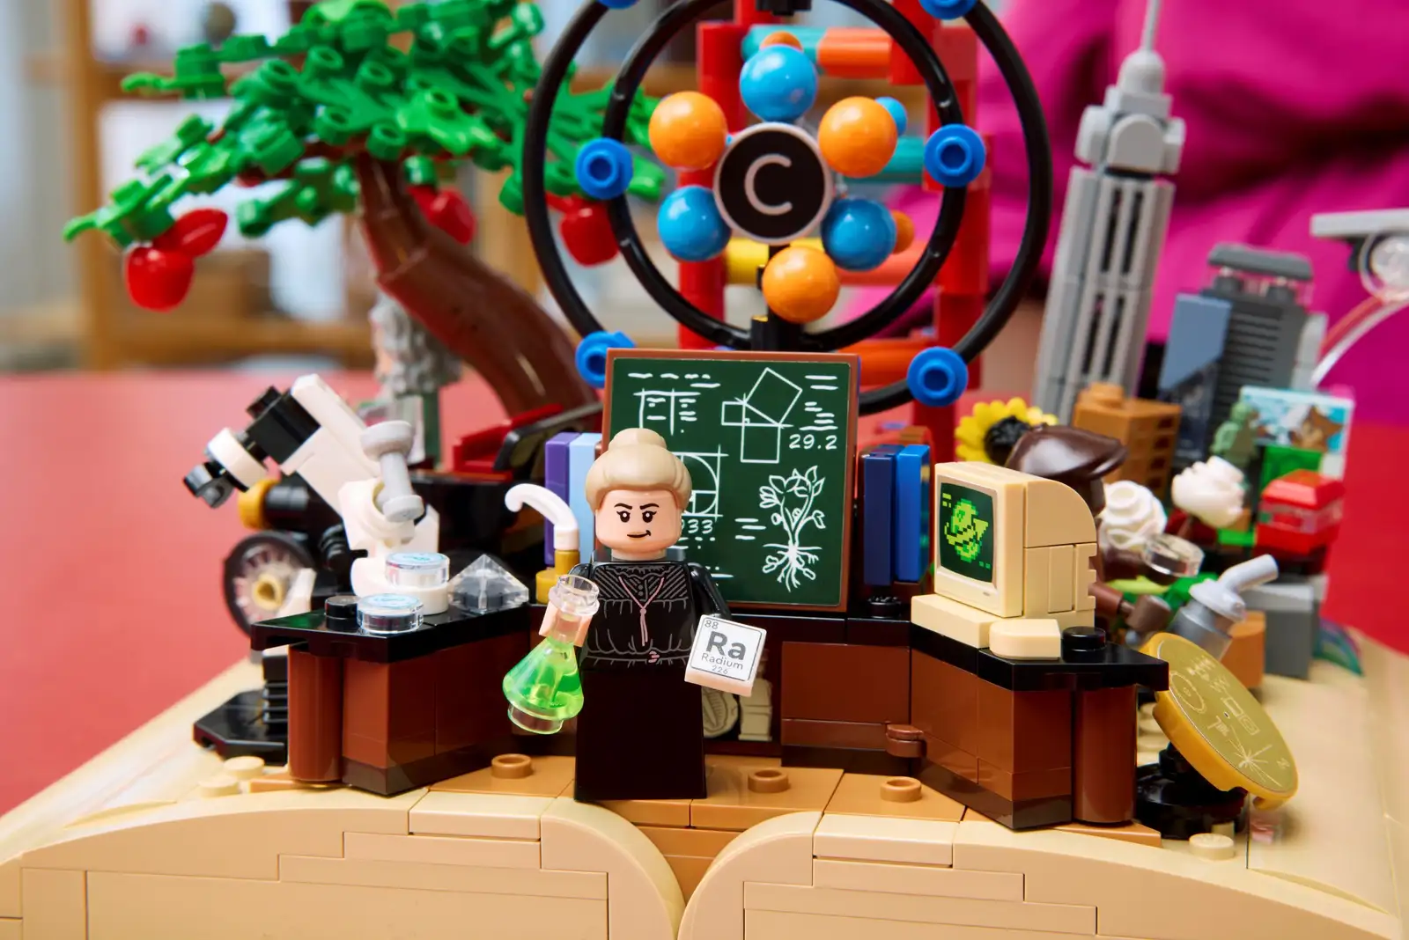
Thanks!!!
Notes:
Thanks to Neann, Brian, Francis, the volunteers & Bagim. It’s a big project to put on an event like this - especially since it’s the first one in the US! But I think I speak for everyone here that it’s great to finally meet some of the US part of our community. indulge me while I introduce sdgr and our relationship to rdkit

Slide 3
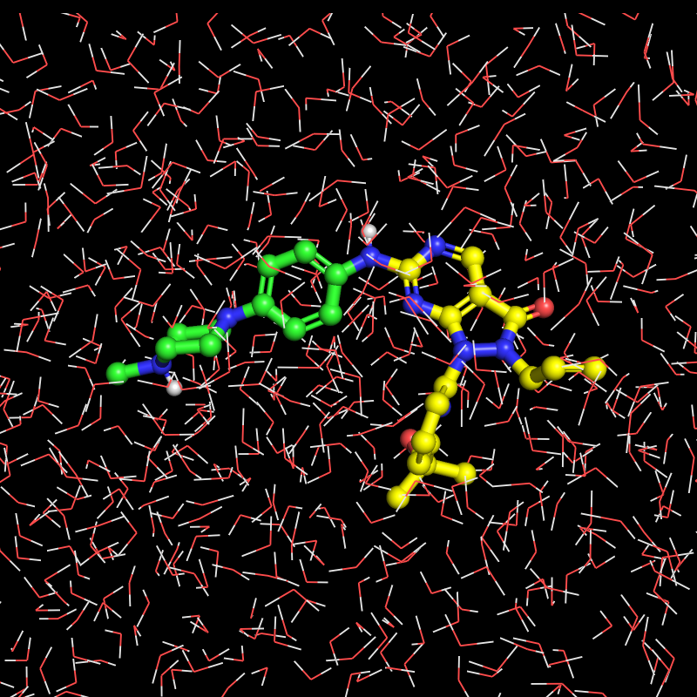
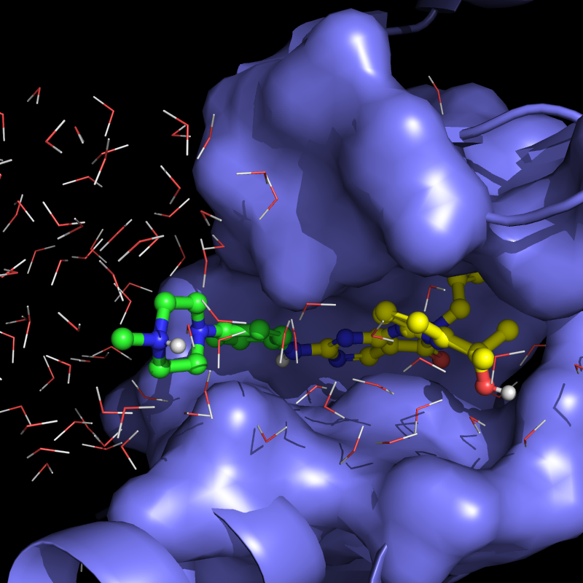
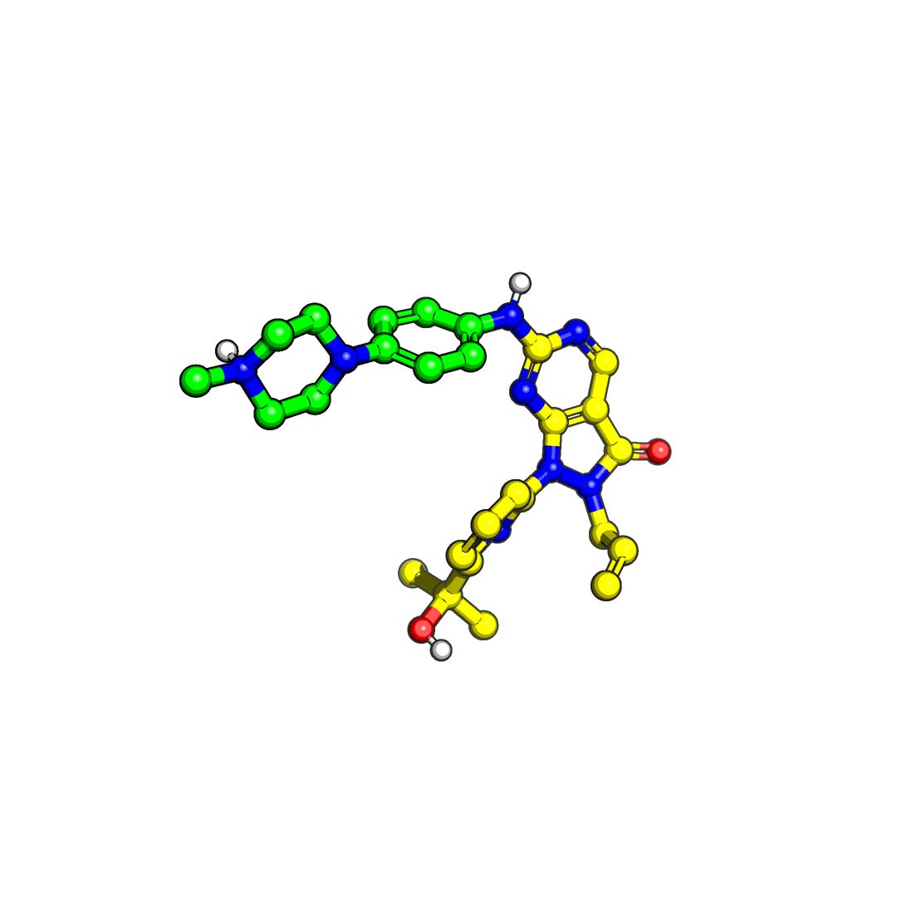
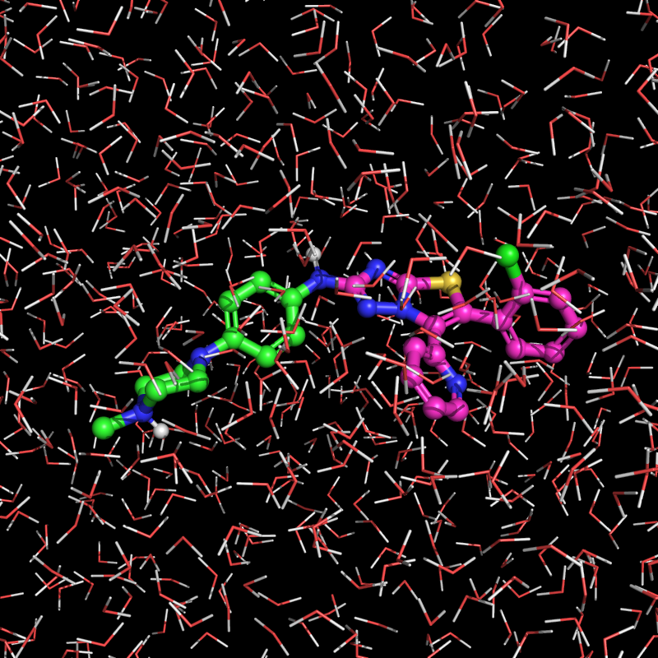
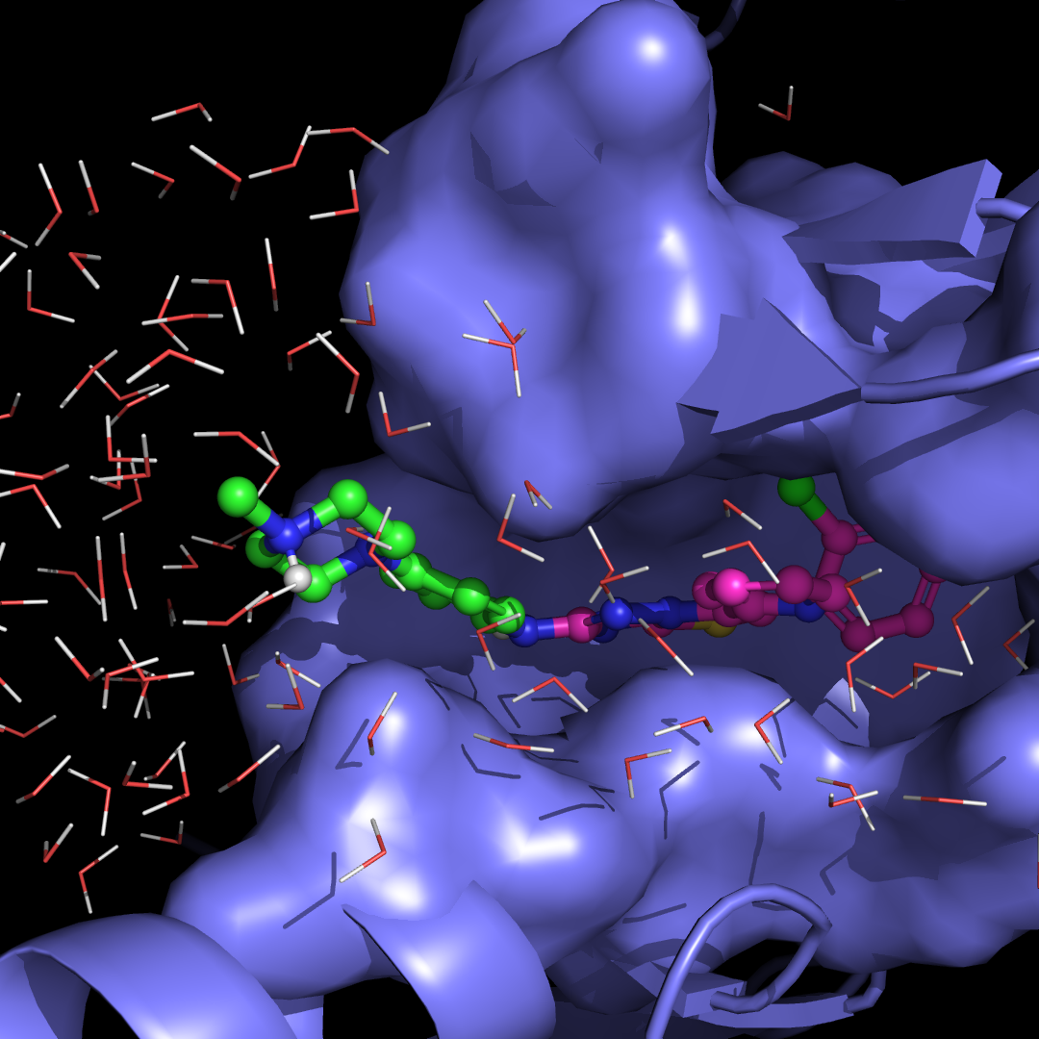
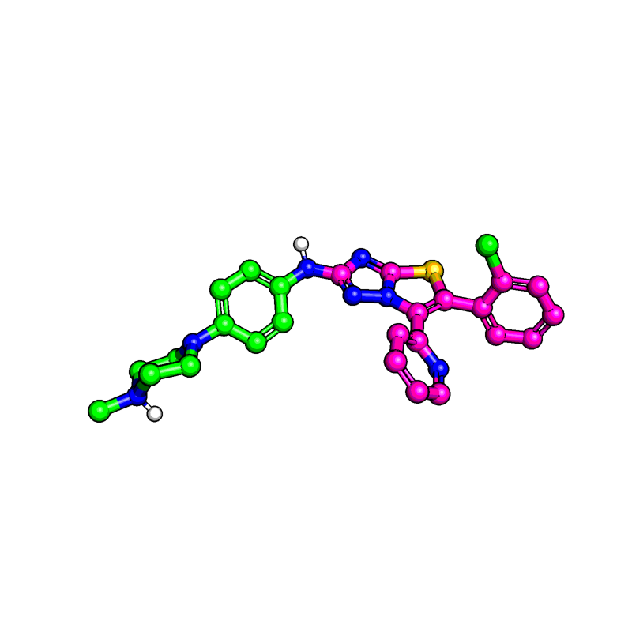
FEP using Desmond MD and FEP+
Reference
Experiment
∆G^{bind}(Reference)
Relative Binding Free Energy
∆G^{bind}(Design) - ∆G^{bind}(Reference)
= ???
Design
???
∆G^{bind}(Design)
Notes:
Who is Sdgr? and what are we doing here? Physics-based tools for chemical discovery. Enterprise tools for sharing chemical information and ideation

Slide 4
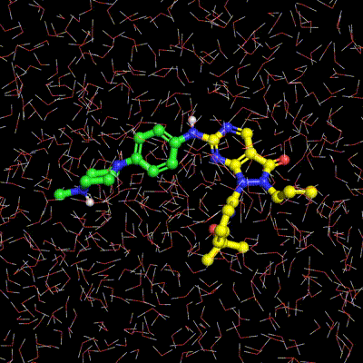

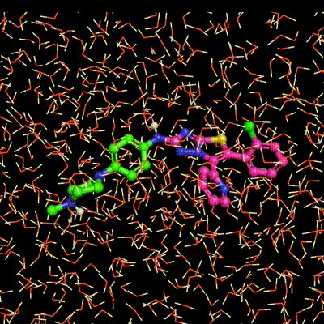

FEP using Desmond MD and FEP+
Reference
Experiment
∆G^{bind}(Reference)
Relative Binding Free Energy
∆G^{bind}(Design) - ∆G^{bind}(Reference)
=
∆G^{complex}(Ref→Design) - ∆G^{solvent}(Ref→Design)
FEP+
∆G^{solvent}
(Ref → Design)
FEP+
∆G^{complex}
(Ref → Design)
Design
???
∆G^{bind}(Design)

Slide 5
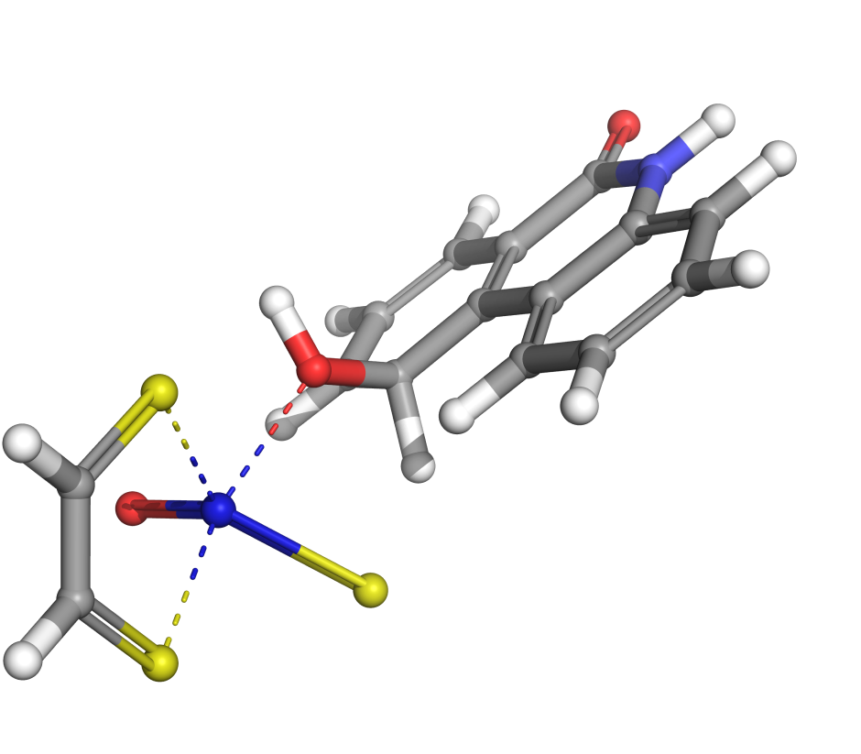
AutoTS using Jaguar QM
Notes:
Quantum calculations of structure and energy - this is a transition state example

Slide 6
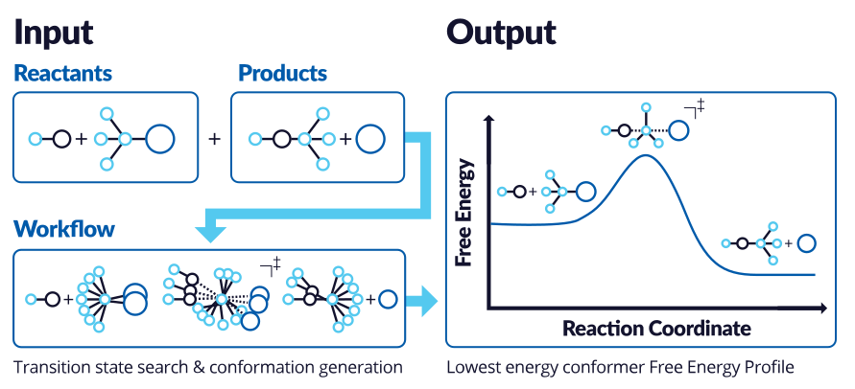
AutoTS using Jaguar QM

Slide 7
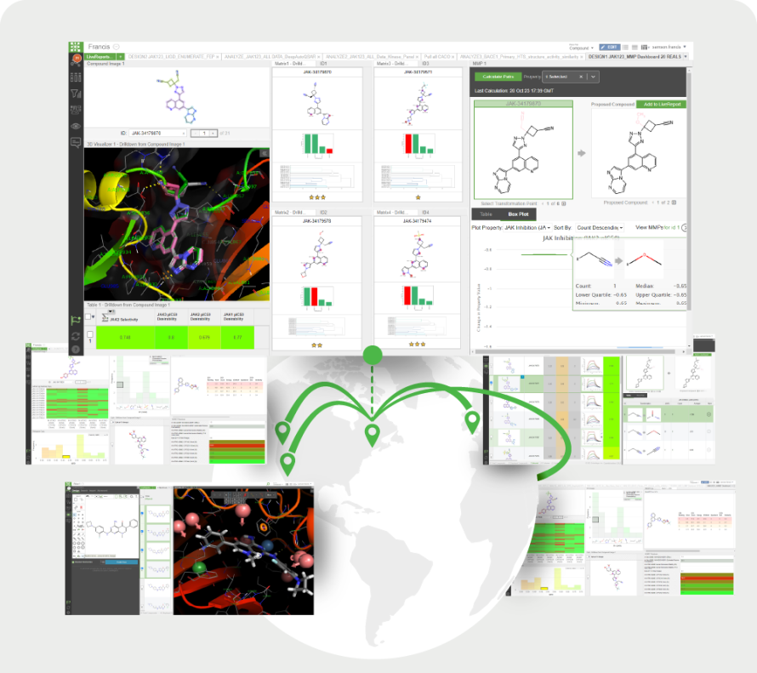
LiveDesign
Notes:
Enterprise chemical data management and collaboration

Slide 8
Cheminformatics critical to setup and analysis
FEP+
AutoTS
SAR/RGD/enumeration tools in LD
So much more
(e.g. SDGR ML scientist and developer here today)
Notes:
But all of this is mediated and enabled by cheminformatics, and cheminformatics tools

Slide 9







Over 30 Years of Innovation
Co-founders Richard Friesner and Bill Goddard launch Schrödinger to advance computational methods for molecular discovery and design
Release of Glide, which offers high- throughput virtual screening of millions of compounds
Release of WaterMap, the first rigorous method of computing protein-bound water locations and energetics
1990
1992
2001
2003
2009
First Software Sale to Brookhaven National Laboratory
Release of Prime, a fully-integrated protein structure prediction program
Co-founding of Nimbus Therapeutics with Atlas Venture
2010
Gilead acquisition of Nimbus ACC program for up to $1.2B
Release of FEP+, the first benchmark method for accurately predicting binding affinity differences among molecules with common core
Launch of Materials Science business
2016
2014
2012
Release of LiveDesign, a next- generation enterprise informatics platform for collaborative drug design
Morphic co-founding with Polaris Partners and Tim Springer
Signed collaboration with Agios, resulting in two FDA- approved cancer medicines
2018
Initial Public Offering
Schrödinger initiates its first clinical trial for a wholly-owned program, SGR-1505
Morphic sale to Lilly for ~$3.2B
2020
2022
2023
2024
Launch of Cryo-EM initiative to join global research centers in leveraging cryo-electron microscopy
Bristol Myers Squibb Collaboration Signed multi-target collaboration with $55M upfront and $2.7B in potential milestone payments
Takeda acquisition of Nimbus TYK2 program for 4B upfront and $2B in potential future payments

Slide 10

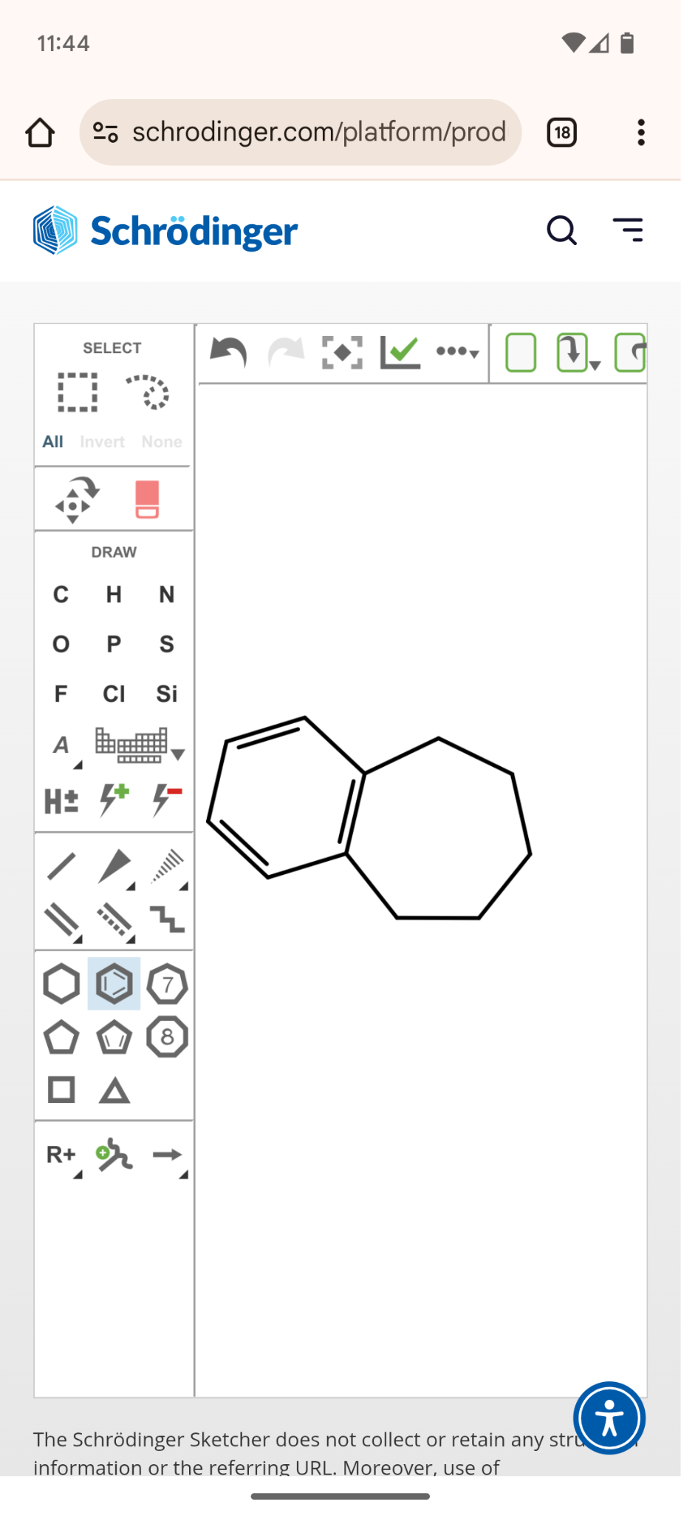
Over 30 Years of Innovation: help from cheminformatics
MMPatty
Cambios/Canvas
1990
1992
2001
2003
2009
2010
ChemAxon
2016
2014
2012
First sdgr commit to RDKit
First sdgr use of RDKit
2018
RDKit
2020
2022
2023
2024
sdgr totally expunges ChemAxon
open access to sdgr/rdkit 2d sketcher:
https://schrodinger.com/2dsketcher
Notes:
One way I think about the timeline is by thinking about the cheminformatics (especially substructure) library we use Substructure, chirality, aromaticity
Helped/encouraged clients and competitors move from other chem toolkits to rdkit (name no names of kits or customers)
So, we’re interested in basic research and the broader scientific community. RDKit is an opportunity for us to derive value from an excellent tool, and to contribute to that community in a way that doesn’t violate our internal IP or obligations to customers or whatever.
https://www.schrodinger.com/wp-content/themes/bigdrop-theme/sketcher-wasm/wasm_shell.html

Slide 11

Monomers
monomers

Slide 12
Scientist need to share & compare their data
RNA designers
Antibody-drug conjugates
Protein
Small peptide
Sugars
Non-biological polymers
Notes:
Initial needs are around sharing and comparison, but <gasp> they also want scientifically aware tooling!

Slide 13
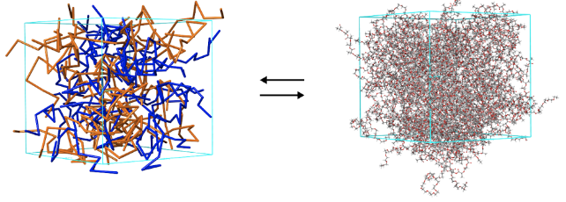
Why Monomers?
Compare molecules with agreed-on monomer identities
Relate monomers/subsequences within a molecule (e.g. CG simulations)
Reduce data transfer costs with implicit or repeated information (pdb, scsr)
Notes:
Monomers as atoms is a silly simple idea - I bet like a third of the people in this room have noodled with it! But there are some complications and quirks that we’ve encountered that lead me to desire some standardization. Also different needs and use-cases.. But monomers come with their own problems…

Slide 14
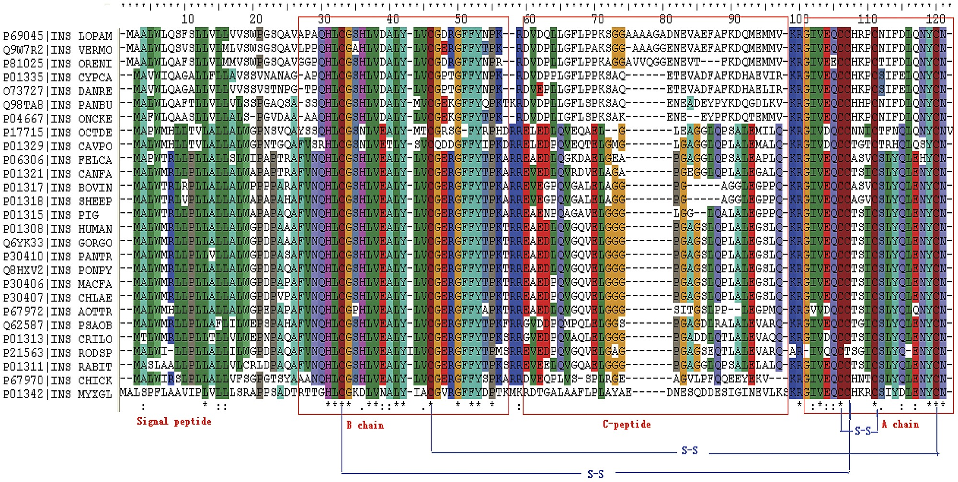
Sequence comparisons
Notes:
is is the sequences of insulin from many species of mammal.
Bioinformatics has a rich, multidecade long history (blast, cobalt, muscle, etc)
Topology/nonlinear connections may matter! Especially for smaller polymers

Slide 15
More than Sequence comparisons
Notes:
is is the sequences of insulin from many species of mammal.
Bioinformatics has a rich, multidecade long history (blast, cobalt, muscle, etc)
Topology/nonlinear connections may matter! Especially? for smaller polymers

Slide 16
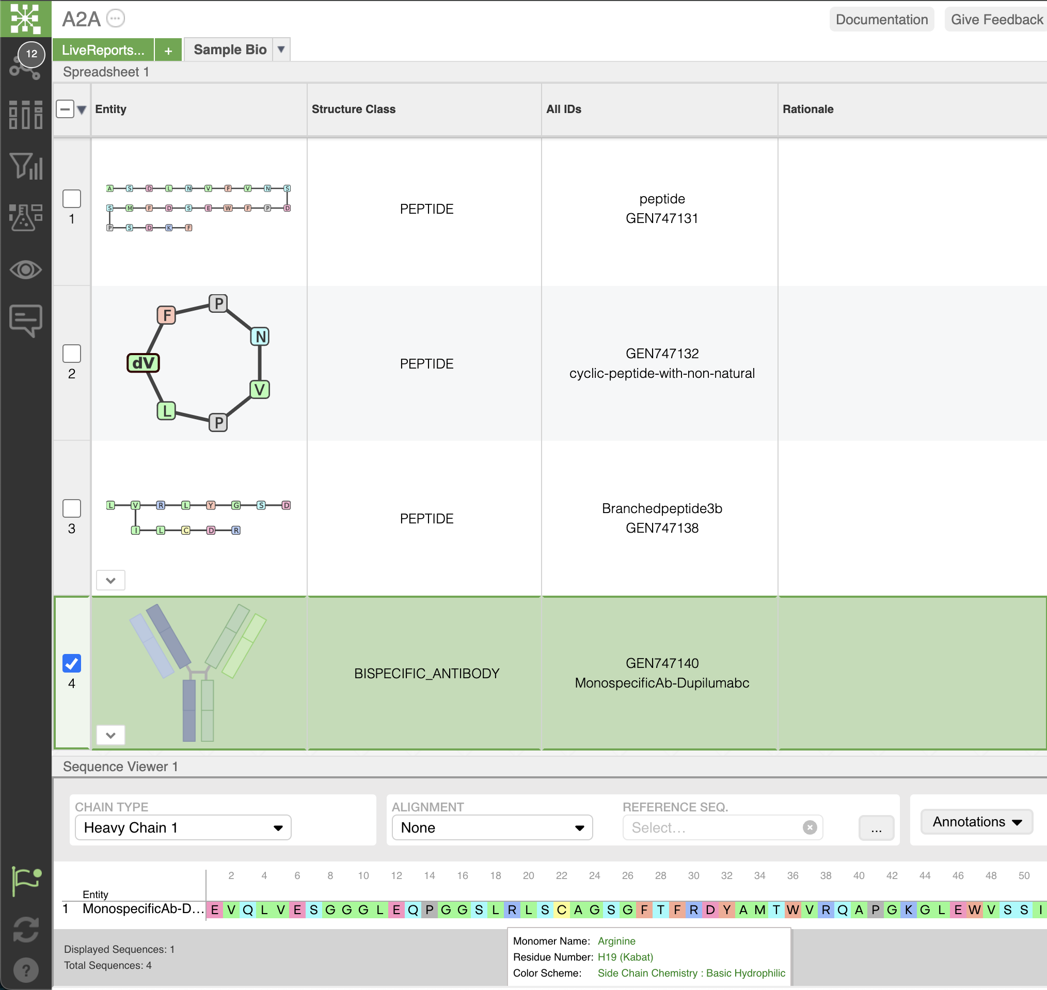
Notes:
Our customers have been using an interface that we developed on top of RDKit to analyze and render monomer-based molecules. I’m here to propose that some of that system should make its way into RDKit. And also to elicit feedback and concerns about the specific implementation details.

Slide 17
rdkit/pull/8218: monomer-based representation of a molecule
Rachel Walker and Hussein Faara
Convince you that “this” belongs in RDKit
Get feedback about problems and issues

Slide 18
Existing monomerish stuff in RDKit
Recursive SMARTS
atomLabel or smilesSymbol
Abbreviations
Biovia Super atoms
SCSR (https://github.com/rdkit/rdkit/pull/8147 from tad@cdd)
Reading/Writing FASTA and HELM v1 (roger@nextmove)
Notes:
Add a picture here of format/modality conversions
Why is there a datastructure for monomer based approaches? talk about registration

Slide 19
atomic featurization
Substructure search
enumeration
SDF, SMILES, PDB, etc.
Depiction
Atomistic
HELM, FASTA, BILN, SCSR
Monomeristic
Depiction
mutation
Motif recognition
sequence featurization
Subsequence search
Homology

Slide 20
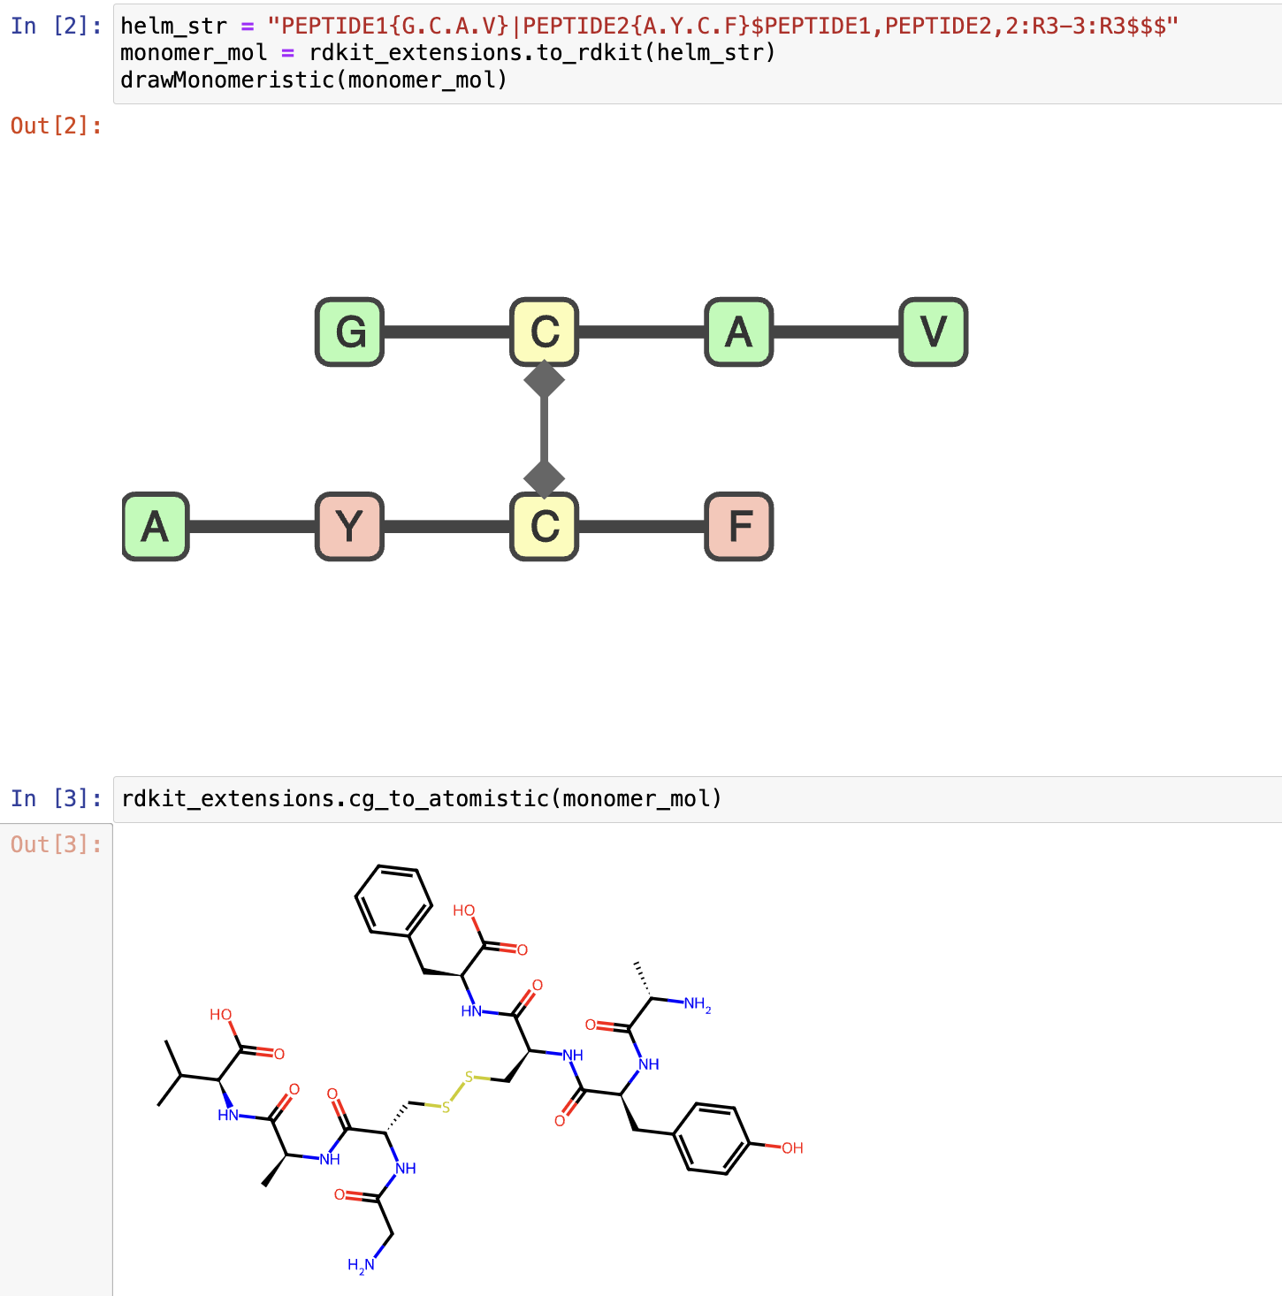

Slide 21
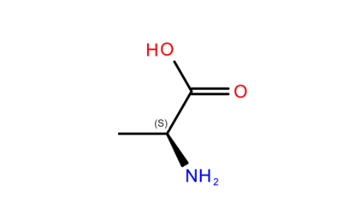
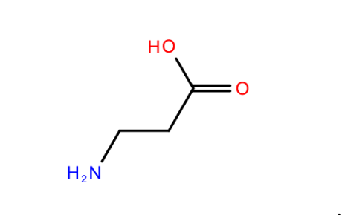
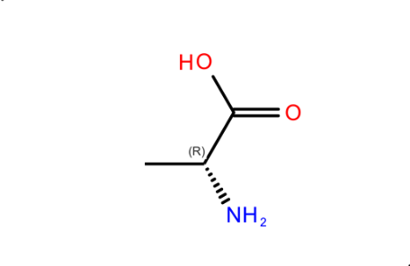
Monomer problems: Number is unbounded
Alanine ꞵ-Alanine d-Alanine
Notes:
alanine balanine dalanine. there is definitely also lalanine, nalaline and more. Only limit is how many CRO hours you wanna use

Slide 22
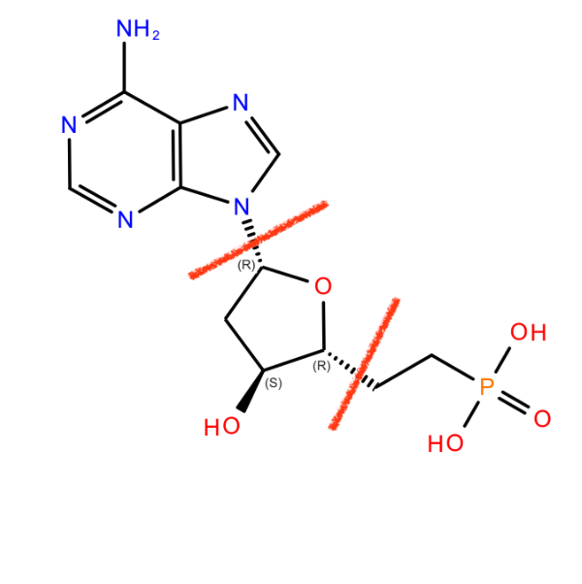
Monomer problems: Disagreements about names
Alanine? A? Ala? L-Alanine?
FASTA sequence: GATTACA
Gly-Ala-Thr-Thr-Ala-Cys-Ala?
Guanine-Adenine-Thymine-Thymine-Adenine-Cytosine-Adenine?
What’s your monomer?
FASTA, PDB
HELM, BILN
Notes:
Reasonable people can disagree about names. We’ve seen disagreements within divisions of a company, or even researchers in a group on mol, database, set of known templates

Slide 23
Approaches: Monomer storage
On mol
Portable
e.g. SCSR
In code
Easy
Domain-specific info
Consistent within application
e.g. RDKit’s FASTA/HELM, current MonomerMol PR
External resource
Consistent across applications
Flexible new monomers
File, Database, API
e.g. internal Schrödinger usage in LiveDesign, PDB
Notes:
When you have a monomer-monomer bond, you need to encode -
* who is the neighbor?
* what atom in this monomer are we talking about?
* what atom in that monomer are we talking about?
“Self-Contained Sequence Representation: Bridging the Gap
between Bioinformatics and Cheminformatics” J. Chem. Inf. Model. 2011, 51, 2186–2208
“BILN:AHuman-Readable LineNotation for Complex Peptides” J. Chem. Inf. Model. 2022, 62, 3942−3947

Slide 24
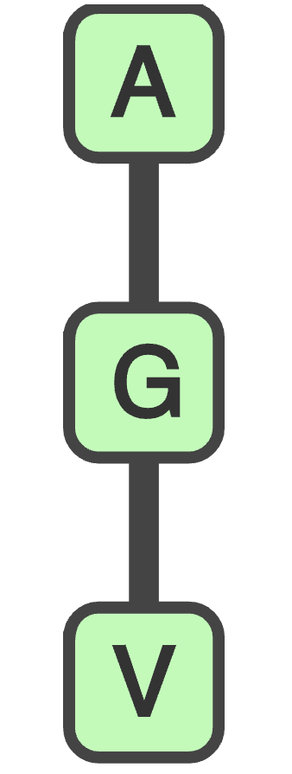
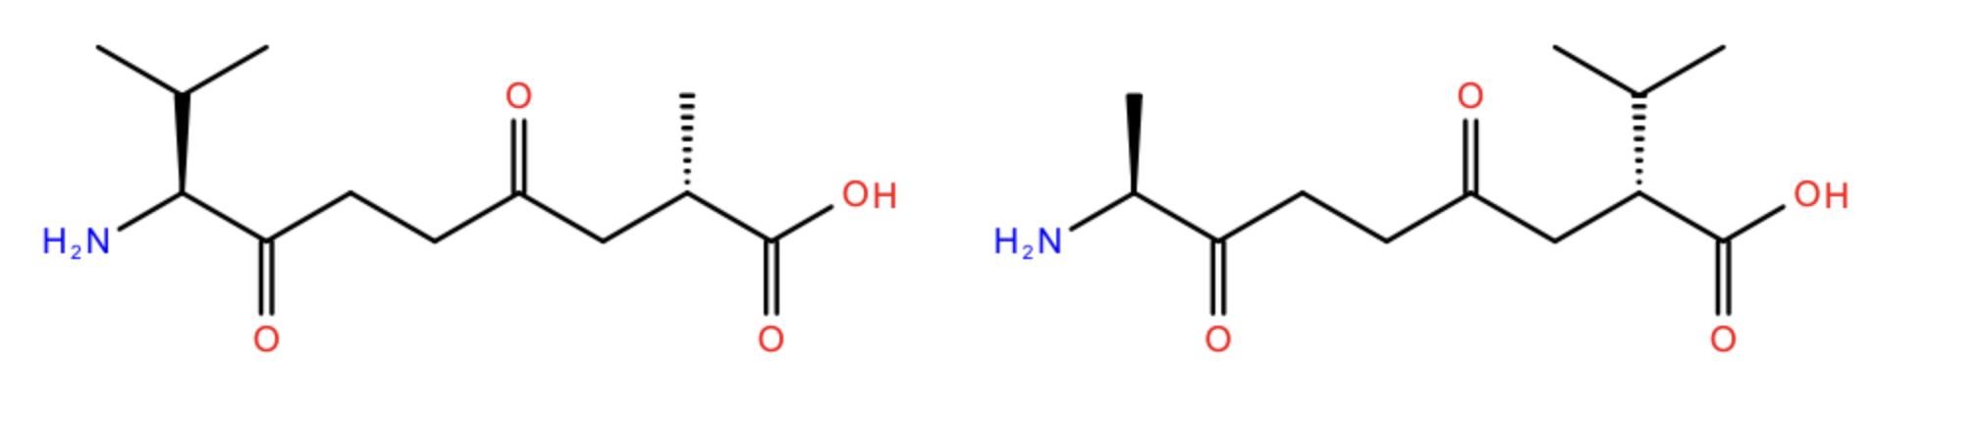
Monomer problems: internal monomer topology
?
Notes:
Ala-Gly differs to Gly-Ala, and Cys-Cys may be a sidechain. Like, monomers have internal structure, and their bonds are non-equivalent. HELM and BILN have "backbone" vs "side-chain" bonds. SCSR marks monomer atoms with the connection site on the internal atomistic representation.

Slide 25
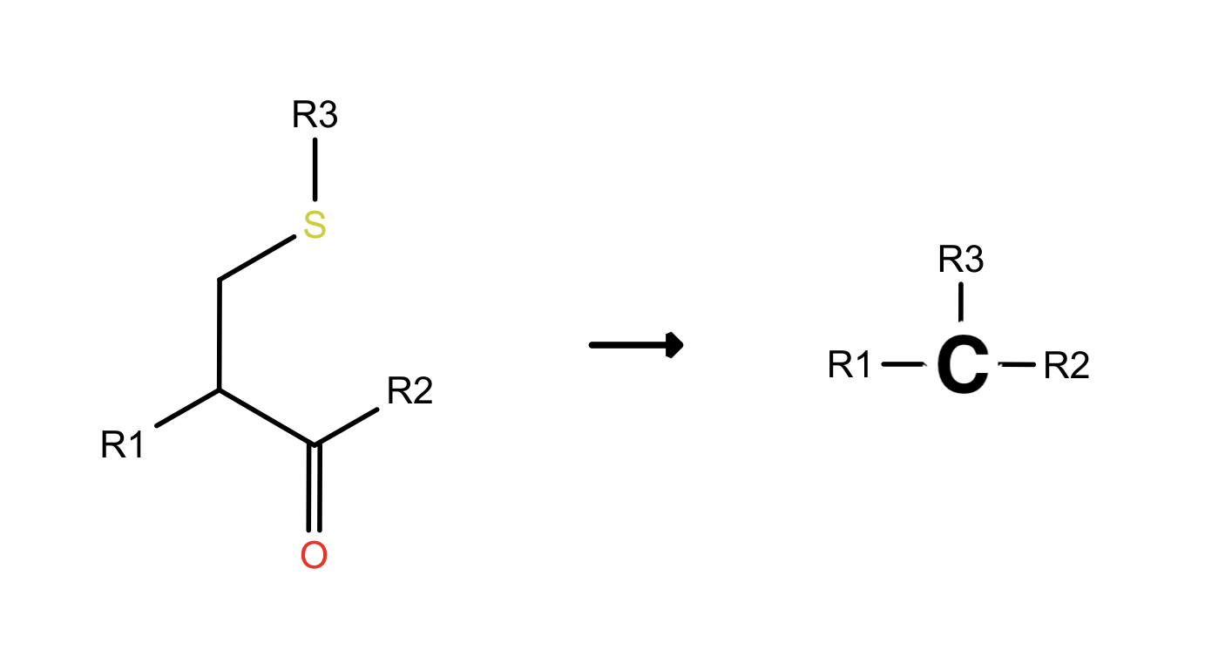
Monomers have internal topology
Notes:
Monomers have internal topology. Check out this cysteine - if another monomer is bound to the cysteine, which “attachment point” does it use? This is the fundamental place that we’re looking for agreement.

Slide 26
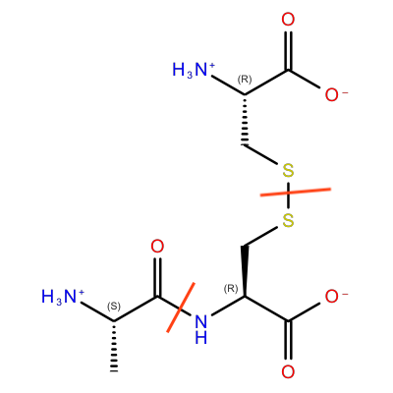
Monomers have internal topology
Neighboring monomer
Internal atom
Other atom
SCSR
M V30 COUNTS 3 2 0 0 0
M V30 BEGIN ATOM
M V30 1 Ala 5.775 -4.775 0.0 0 CLASS=AA ATTCHORD=(2 2 Br) SEQID=1
M V30 2 Cys 6.641 -5.275 0.0 0 CLASS=AA ATTCHORD=(4 1 Al 3 Cx) SEQID=1
M V30 3 Cys 6.641 -6.275 0.0 0 CLASS=AA ATTCHORD=(2 2 Cx) SEQID=1
M V30 END ATOM
M V30 BEGIN BOND
M V30 1 1 1 2
M V30 2 1 2 3
M V30 END BOND
M V30 END CTAB
HELM
PEPTIDE1{A.C}|PEPTIDE2{C}$PEPTIDE1,PEPTIDE2,2:R3-1:R3
BILN
A-C(1,3).C(1,3)

Slide 27
Monomers have internal topology
Neighboring monomer
Internal atom
Other atom
SCSR
M V30 COUNTS 3 2 0 0 0
M V30 BEGIN ATOM
M V30 1 Ala 5.775 -4.775 0.0 0 CLASS=AA ATTCHORD=(2 2 Br) SEQID=1
M V30 2 Cys 6.641 -5.275 0.0 0 CLASS=AA ATTCHORD=(4 1 Al 3 Cx) SEQID=1
M V30 3 Cys 6.641 -6.275 0.0 0 CLASS=AA ATTCHORD=(2 2 Cx) SEQID=1
M V30 END ATOM
M V30 BEGIN BOND
M V30 1 1 1 2
M V30 2 1 2 3
M V30 END BOND
M V30 END CTAB
HELM
PEPTIDE1{A.C}|PEPTIDE2{C}$PEPTIDE1,PEPTIDE2,2:R3-1:R3
BILN
A-C(1,3).C(1,3)
neighbor index
internal atom
other atom

Slide 28
Approaches: Internal topology/connectivity
Atom based tracking
Matches how the file is written to disk:
Add a property to each Monomer with the neighbor, how it’s connected, and what atom inside the monomer is used…
Easy to read/write
e.g. atom.AddProp(‘attach’, (‘Al’, 1))
Bond based tracking
Matches chemical meaning of linkage
Add a property to each Bond with the connection types
Mutation of sites without modification of connection type
Simplifies topology-sensitive substructure searching
bond.AddProp(‘linkage’, ‘1-2’)
Notes:
When you have a monomer-monomer bond, you need to encode -
* who is the neighbor?
* what atom in this monomer are we talking about?
* what atom in that monomer are we talking about?
“Self-Contained Sequence Representation: Bridging the Gap
between Bioinformatics and Cheminformatics” J. Chem. Inf. Model. 2011, 51, 2186–2208
“BILN:AHuman-Readable LineNotation for Complex Peptides” J. Chem. Inf. Model. 2022, 62, 3942−3947

Slide 29
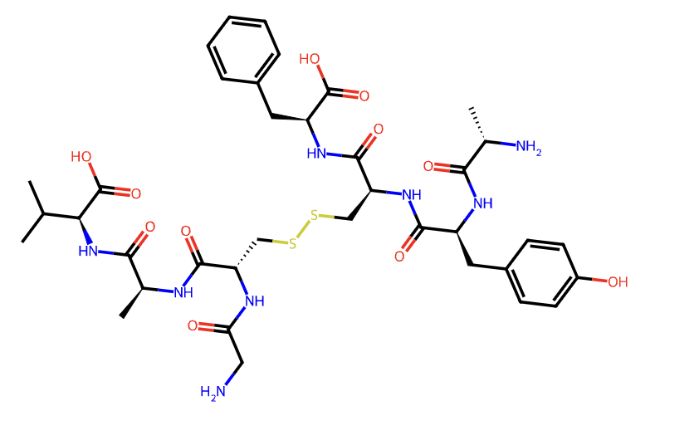
Problem: monomer identification
Notes:
How did you get your atomistic structure if it didn’t come from monomers?

Slide 30
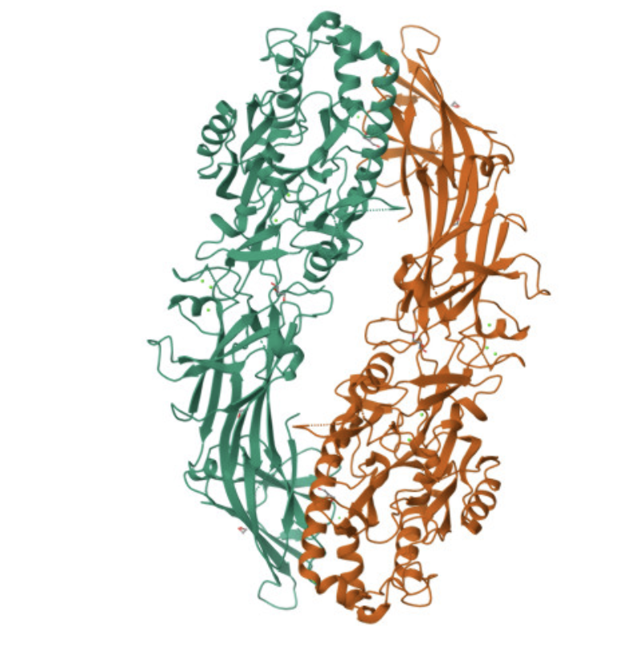
Problem: monomer identification
Notes:
7dan

Slide 31
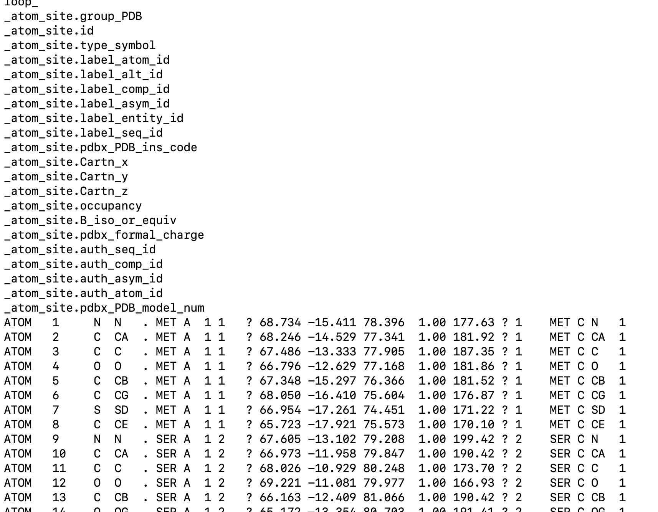
Approaches: monomer identification

Slide 32
atomic featurization
Substructure search
enumeration
SDF, SMILES, PDB, etc.
Depiction
Atomistic
HELM, FASTA, BILN, SCSR
Monomeristic
Depiction
mutation
Motif recognition
sequence featurization
Subsequence search
Homology

Slide 33
thanks
rachelnwalker
whosayn
ricrogz
Cindy Gerson, Jen Knight

